Slide 1
Analysis of some features
for prognosis of Alzheimer onset:
Probability theory & Information theory
Luca, Alexandra, Ingrid
MMIV-ML group meeting, 13 January 2022

Slide 2






Mild Cognitive Impairment
time
Alzheimer Disease
Mild Cognitive Impairment
(stable)

Slide 3
⚤ Gender
⚤ AGE
⏰ RAVLT
⏰ ANARTERR
⏰ GDTOTAL
⏰ TRABSCOR
⏰ CATANIMSC
⏰ TRAASCOR
⏰ AVDELTOT
⏰ AVDEL30MIN
🧠 LRHHC
🧠 LRLV
👪 FAQ
🧬 Apoe4
How ‘good’ are these features at prognosing the later onset of Alzheimer?

Slide 4
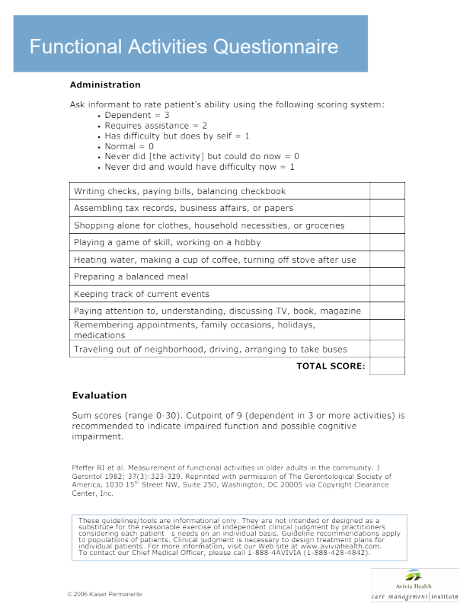
⚤ Gender
⚤ AGE
⏰ RAVLT
⏰ ANARTERR
⏰ GDTOTAL
⏰ TRABSCOR
⏰ CATANIMSC
⏰ TRAASCOR
⏰ AVDELTOT
⏰ AVDEL30MIN
🧠 LRHHC
🧠 LRLV
👪 FAQ
🧬 Apoe4

Slide 5


Data source:
Ingrid’s study: 12+1 variates, 678 datapoints
Alexandra’s study: 11+1 variates, 708 datapoints (43 missing values)
Computation time: ~65 h/study (3 parallel sessions to assess numeric convergence)
HPC

Slide 7
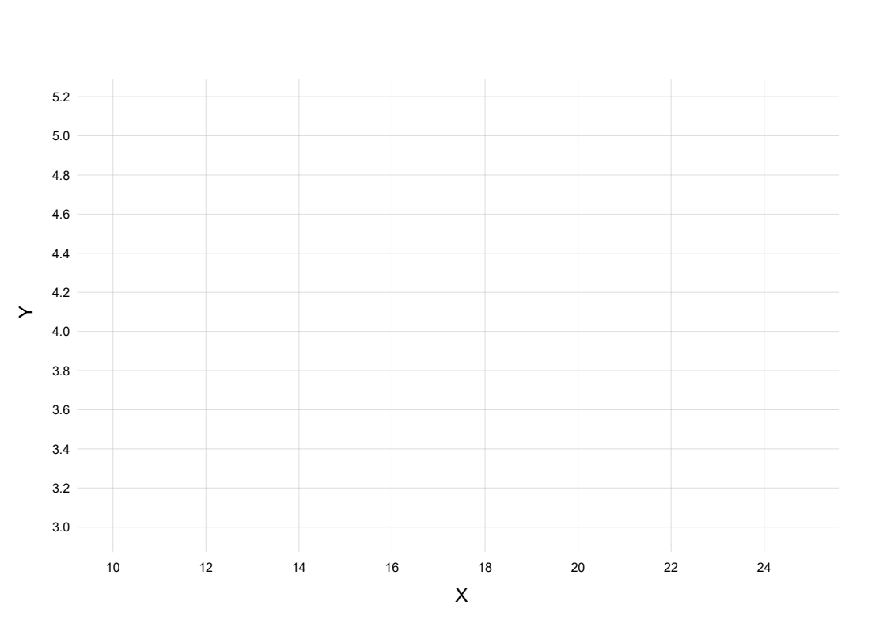
Plot (X, Y) for all past, present, future subjects
+

Slide 8
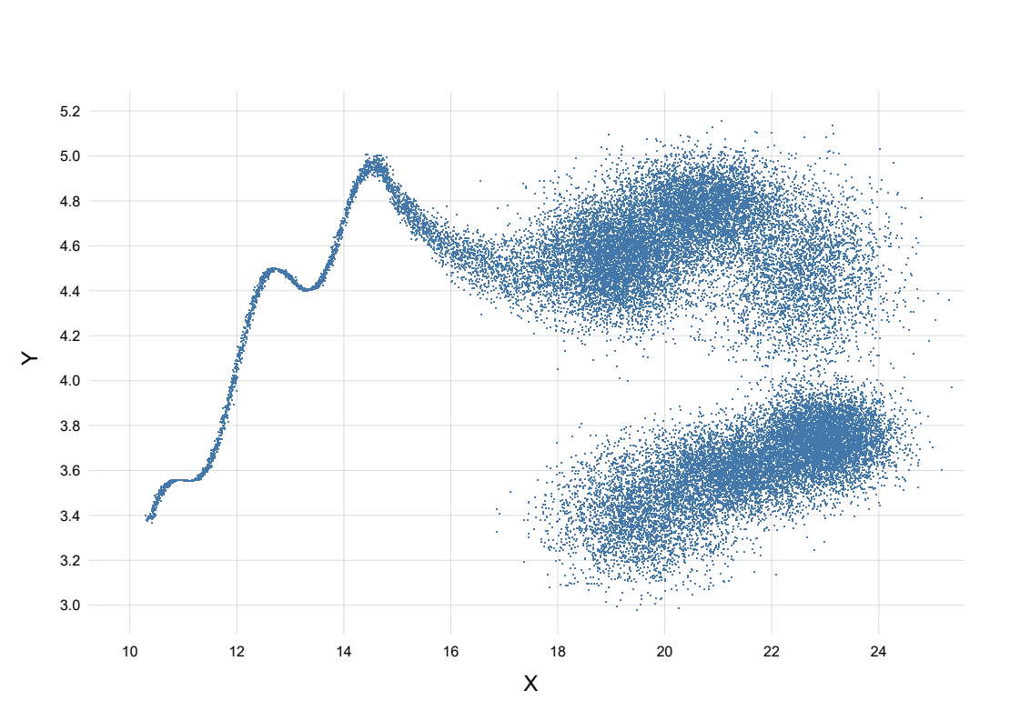
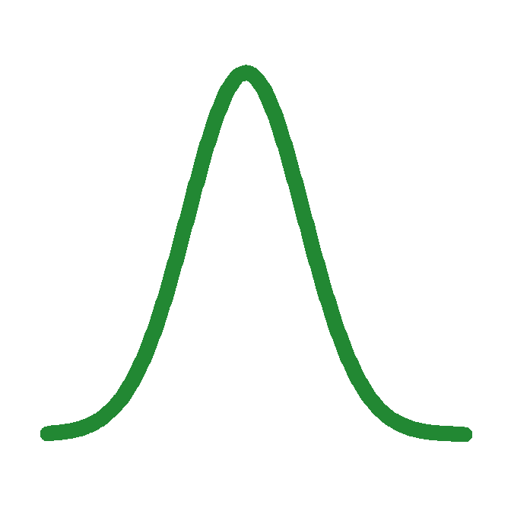
New patient: X = 16
⇒ Y ≈ 4.5–4.7
F(X, Y): population distribution of X, Y

Slide 9
P(y | x) = ∫ F(y | x) p(F | data) dF

Slide 10
F(X, Y): population distribution of X, Y

Slide 11
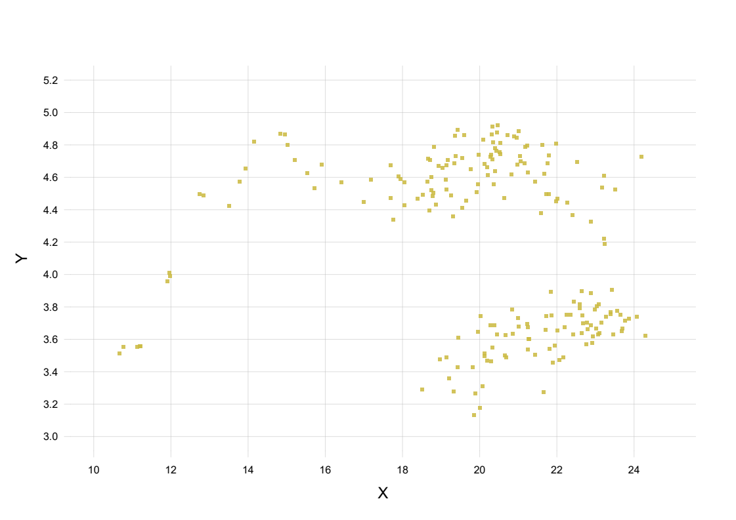

Slide 12
P(y | x) = ∫ F(y | x) p(F | data) dF
P(y | x) = ∫ F(y | x) p(F | data) dF
probability = average over all possible population distributions
p(F | data) ∝ F(y1, x1) × F(y2, x2) × F(y3, x3) × ... × p(F | prior info)
p(F | data) ∝ F(y1, x1) × F(y2, x2) × F(y3, x3) × ... × p(F | prior info)
p(F | data) ∝ F(y1, x1) × F(y2, x2) × F(y3, x3) × ... × p(F | prior info)
how well the ‘candidate’ distribution fits the data
extra-data knowledge

Slide 13
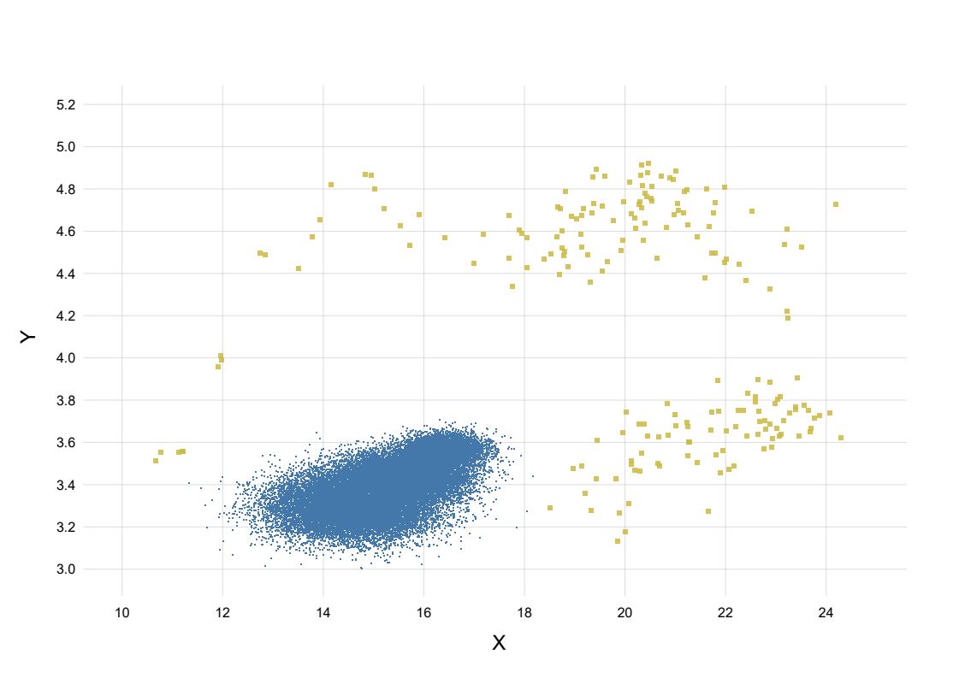
poor candidate: doesn’t fit the data
F(y1, x1) × F(y2, x2) × F(y3, x3) × ... × p(F | prior info)
low
high
candidate F

Slide 14
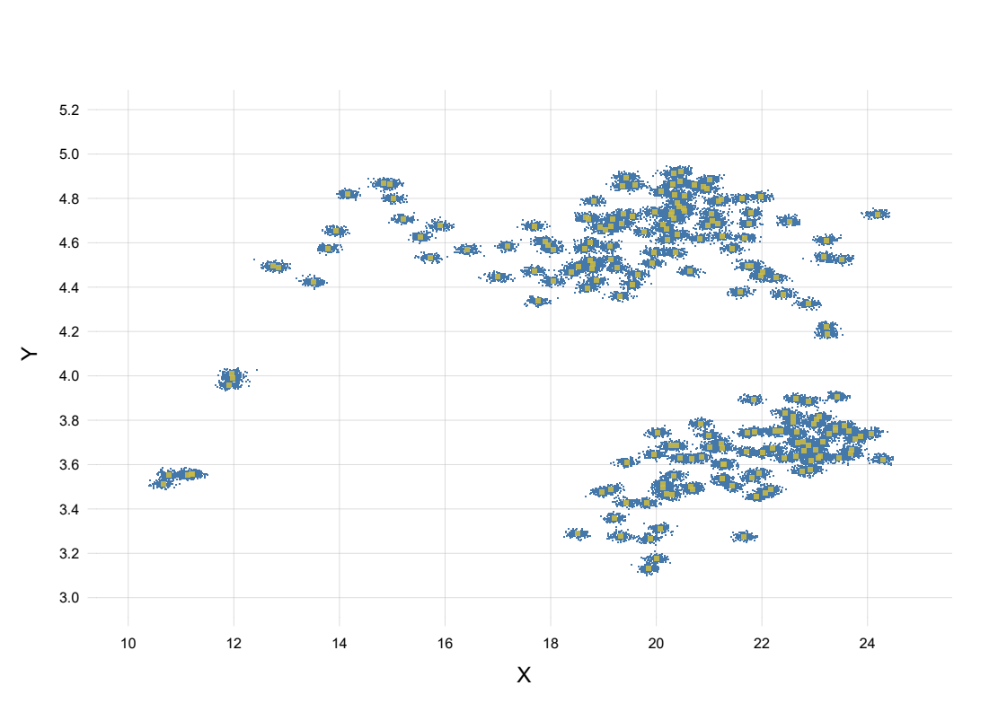
poor candidate: biologically implausible
F(y1, x1) × F(y2, x2) × F(y3, x3) × ... × p(F | prior info)
high
low
candidate F

Slide 15
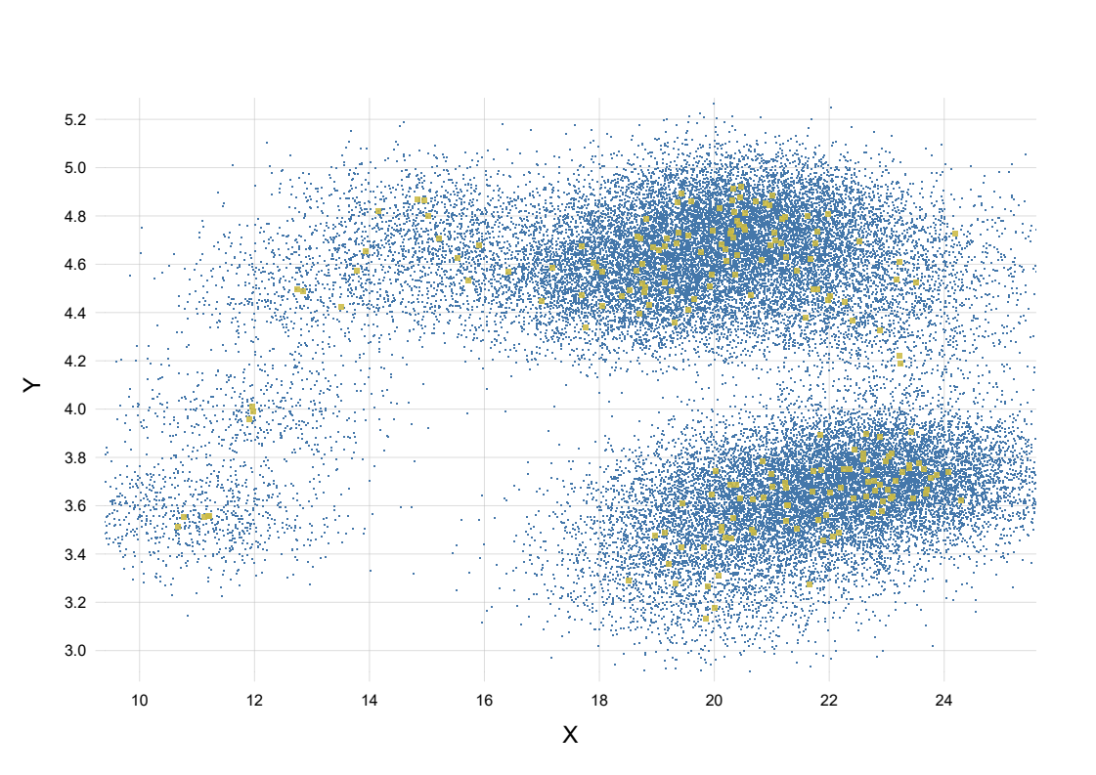
reasonable candidate
F(y1, x1) × F(y2, x2) × F(y3, x3) × ... × p(F | prior info)
high
high
candidate F

Slide 16
intuition → mathematics

Slide 17
first principles → mathematics → intuition
(‘Bayesian’)

Slide 18
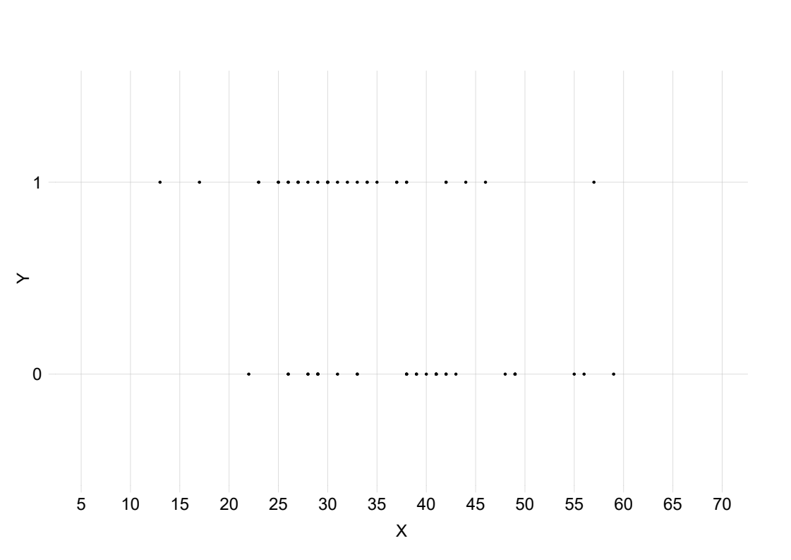
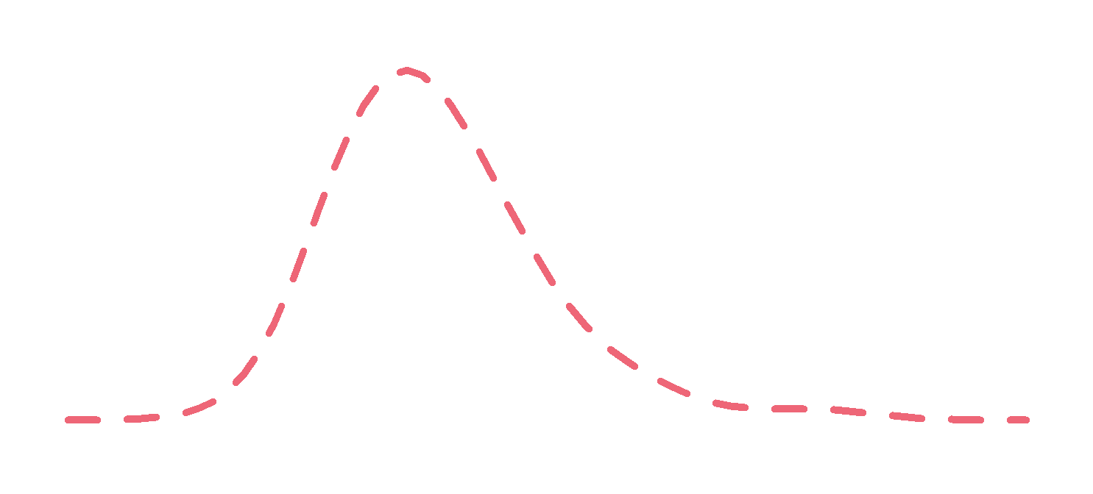
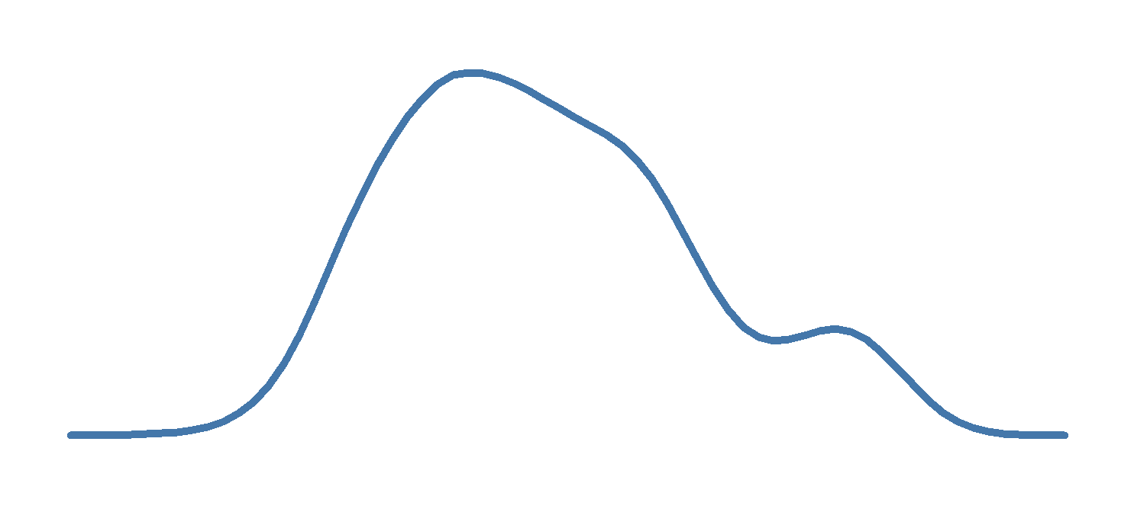

Slide 20
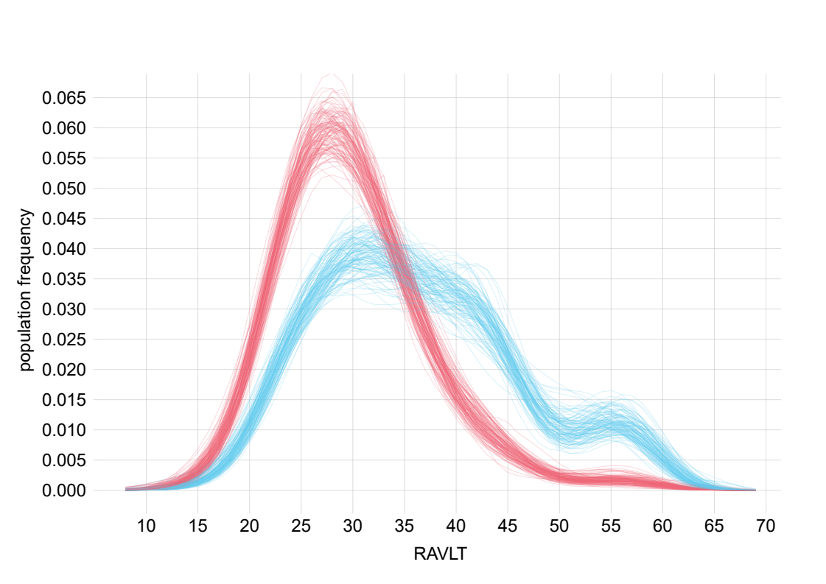
MCI
AD

Slide 21
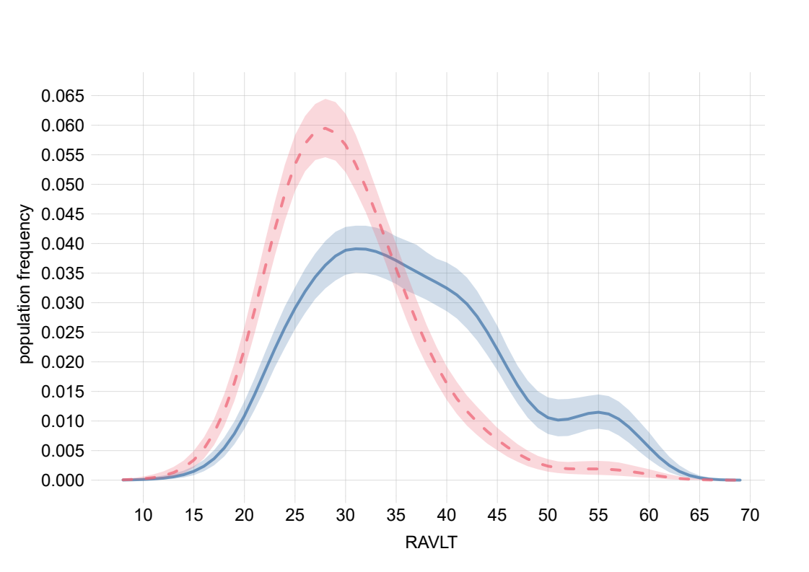
MCI
AD
87.5% credible interval

Slide 22
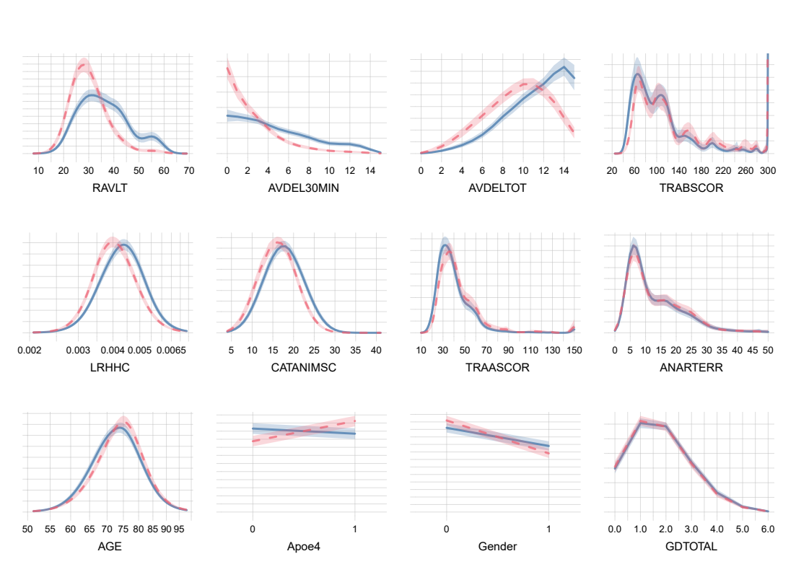
MCI
AD
87.5% credible interval
🧠
🧬

Slide 23
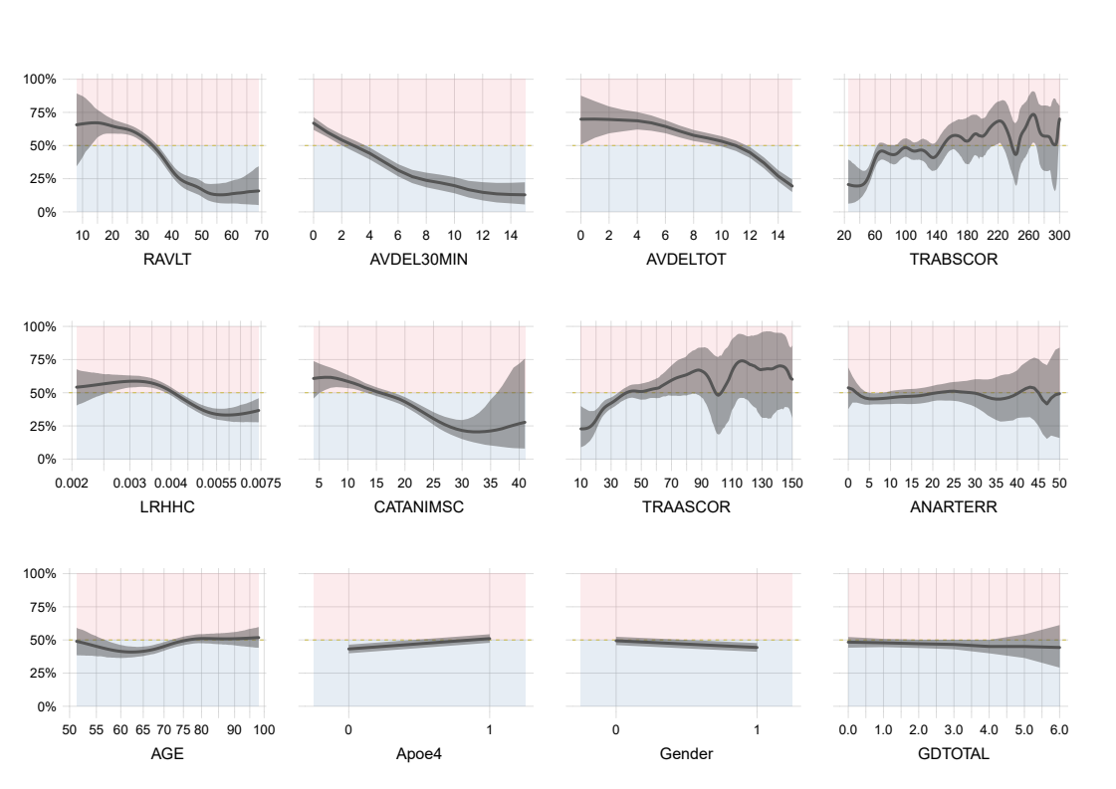
87.5% credible interval
Probability of AD onset
🧠
🧬

Slide 24
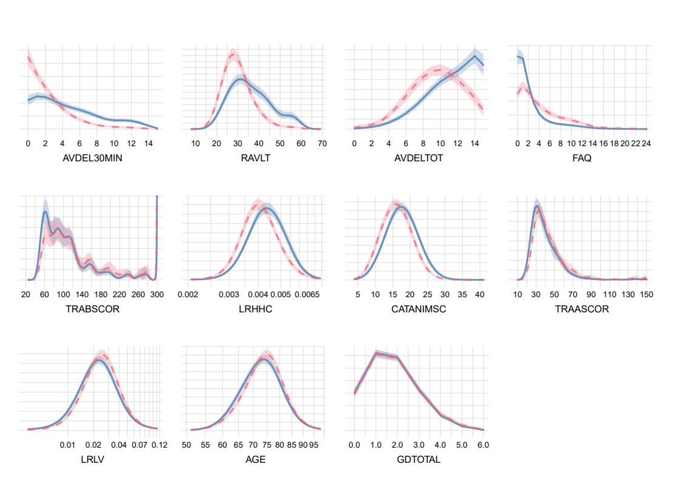
MCI
AD
87.5% credible interval
👪
🧠
🧠

Slide 25
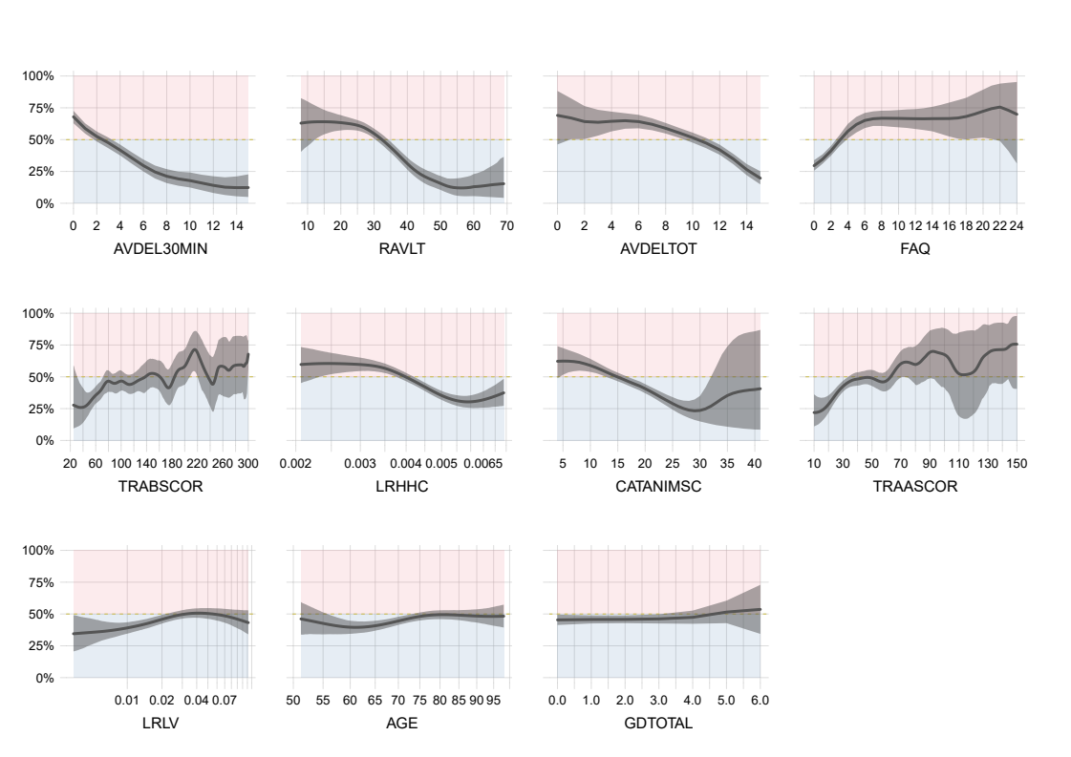
87.5% credible interval
👪
Probability of AD onset
Probability of AD onset
🧠
🧠

Slide 26
Interesting characteristics of F(Y, X) in Ingrid’s & Alexandra’s studies:
• Several high-density regions in the 12D space
• Some features seem more robust if used in a ‘discriminative’ way: P(Y | X),
others in a ‘generative’ way: P(X | Y)

Slide 28
How to quantify the ‘importance’ or ‘prognostic power’ of a set of features?
“Language is a product of, and reflects, thinking. Sloppy usage reflects sloppy thinking, a kind of thinking incompatible with good scientific habits of mind”
(D. J. Helfand)

Slide 29
Prediction problem:
guess the six digits of the winning lottery ticket ??????
Clue A: ✔✔✔✔??
Clue B: ✔✔✔?✔?
Clue C: ???✔✔✔
What is the ‘importance’ or ‘predictive power’ of each clue?

Slide 30
Scenario 1: we can use only one clue
Clue A: ✔✔✔✔??
Clue B: ✔✔✔?✔?
Clue C: ???✔✔✔
Best: A or B (each gives 1/81 winning chance)
Worst: C (gives 1/729 winning chance)
increasing
importance

Slide 31
Scenario 2: we can use all clues
Clue A: ✔✔✔✔??
Clue B: ✔✔✔?✔?
Clue C: ???✔✔✔
→ We fully know the winning number! 💰

Slide 32
Scenario 2: what happens if we discard clues?
Clue A: ✔✔✔✔??
Clue B: ✔✔✔?✔?
Clue C: ???✔✔✔
• Discard A: still 100% win ⇒ A has ‘importance = 0’
• Discard B: still 100% win ⇒ B has ‘importance = 0’
• Discard A and B: 1/9 winning chance
⇒ A and B together have ‘importance > 0’
‘ 0 + 0 ≠ 0 ’

Slide 33
‘Importance’ or ‘predictive power’ is not an additive property

Slide 34
Scenario 3: we have to discard one clue. Which?
Clue A: ✔✔✔✔??
Clue B: ✔✔✔?✔?
Clue C: ???✔✔✔
discard A: still 100% win
discard B: still 100% win
discard C: 1/9 winning chance
increasing
importance
→ If we have to discard one clue, it’s most important that we keep C

Slide 35
increasing importance
Scenario 1:
choose one clue
Scenario 3:
discard one clue
A
B
C
A
B
C
increasing importance

Slide 36
‘Importance’ or ‘predictive power’ of X is context-dependent
(which other features are we considering?)

Slide 37
x = 11.5 ⇒ y ≈ 3.60–3.65

Slide 38
x = 22 ⇒ y ≈ 3.50–3.85 or 4.25–4.90

Slide 39
What is the ‘overall predictive power’ of X?

Slide 40
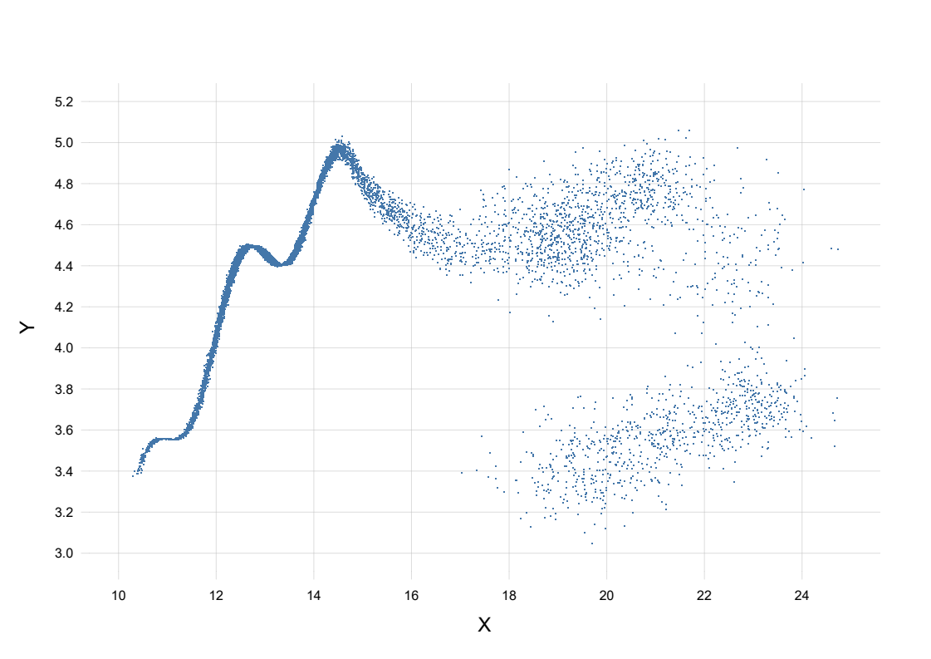

What is the ‘overall predictive power’ of X?
P(X)

Slide 41
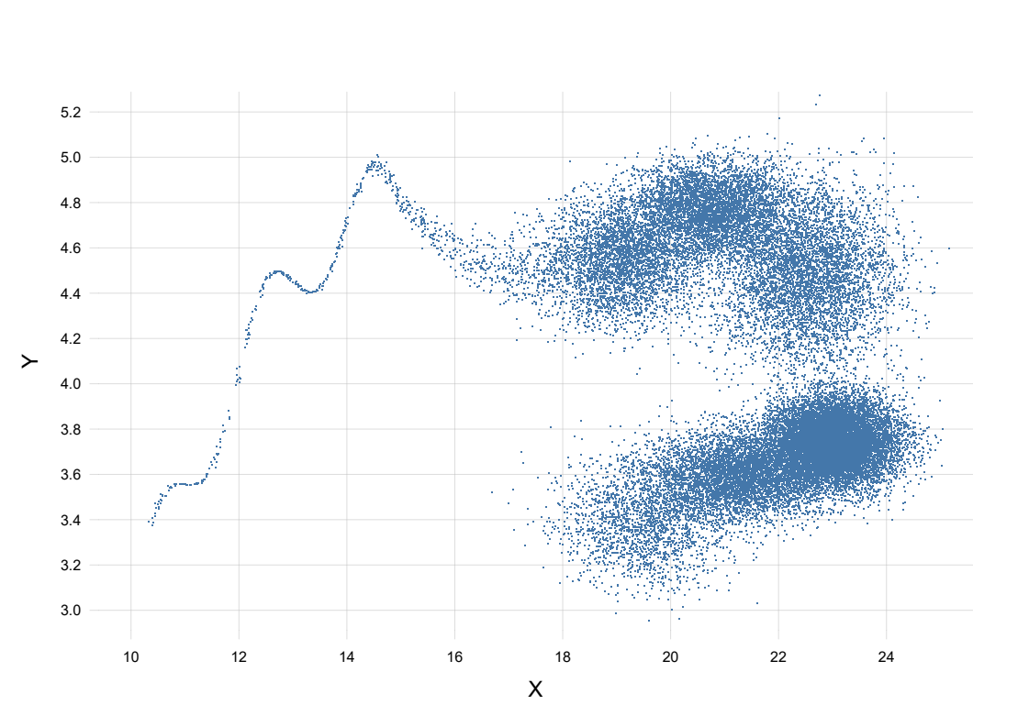
What is the ‘overall predictive power’ of X?
P(X)

Slide 42
The ‘importance’ or ‘predictive power’ of X depends on P(X)
⚠ Careful with ‘data balancing’! ⚠

Slide 43
P(Y|X) P(X) ≡ P(X|Y) P(Y)

Slide 44
!
P(Y|X) P(X) ≡ P(X|Y) P*(Y)

Slide 45
? ? ?
P*(Y|X) P*(X) ≡ P*(X|Y) P*(Y)

Slide 47
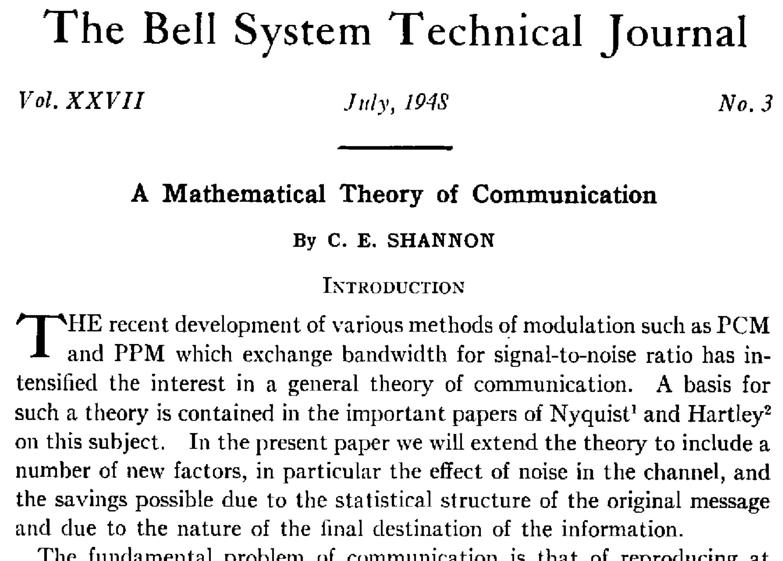
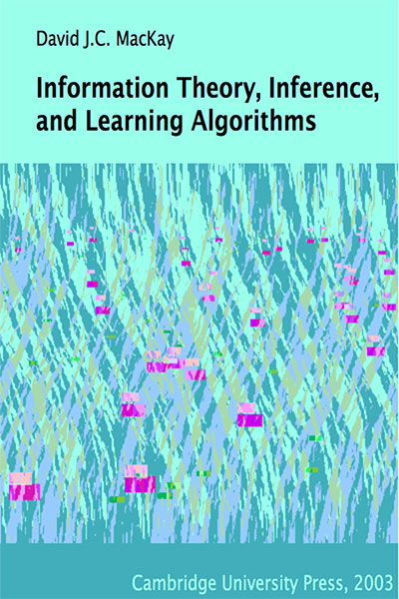



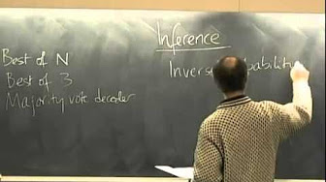
Information Theory
https://www.inference.org.uk/itila/book.html
https://youtube.com/playlist?list=PLruBu5BI5n4aFpG32iMbdWoRVAA-Vcso6

Slide 48
‘predictive power’ of X for Y ≔ Mutual information between Y and X
(mean transinformation content)
I(Y; X1, X2) ≥ I(Y; X1)
but I(Y; X1, X2) ≠ I(Y; X1) + I(Y; X2)
I(Y; X1, X2) ≥ I(Y; X2)

Slide 49


Slide 50
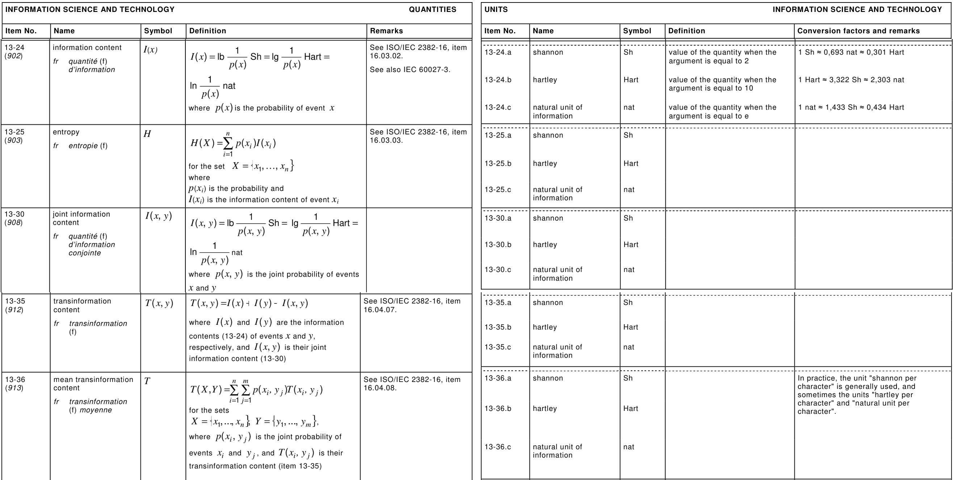

Slide 51
If Y is binary:
0 Sh ≤ I(Y; X) ≤ 1 Sh
X and Y are independent
Using X is no better than flipping a coin
Y is a deterministic function of X
X always yields perfect predictions
I(Y; X) = 0.22 Sh
In N = 100 new prognoses:
• we are completely certain about 22
• we are completely uncertain about 100 – 22 = 78
→ approx 22 + 78/2 = 61 correct prognoses (TP+TN)
Any prognostic algorithm
which does less than this
is performing poorly
Upper bound ≈
correct prognoses
Maximum accuracy attainable
by any algorithm which uses only feature set X

Slide 53
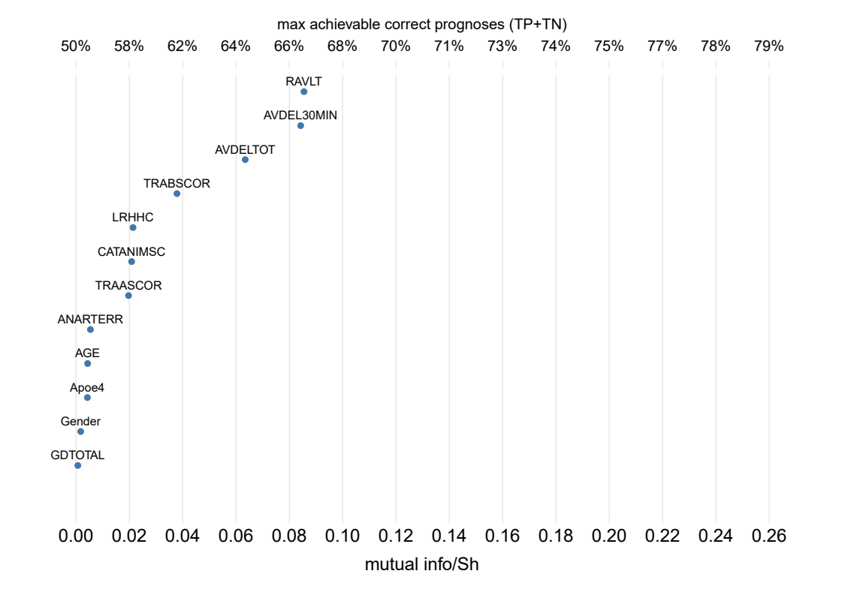
🧠
🧬

Slide 54
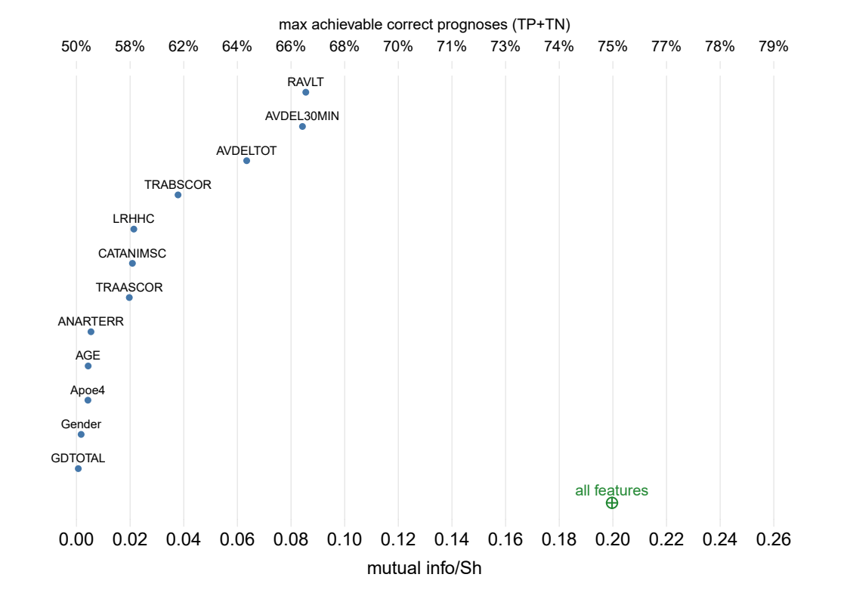
🧠
🧬

Slide 55
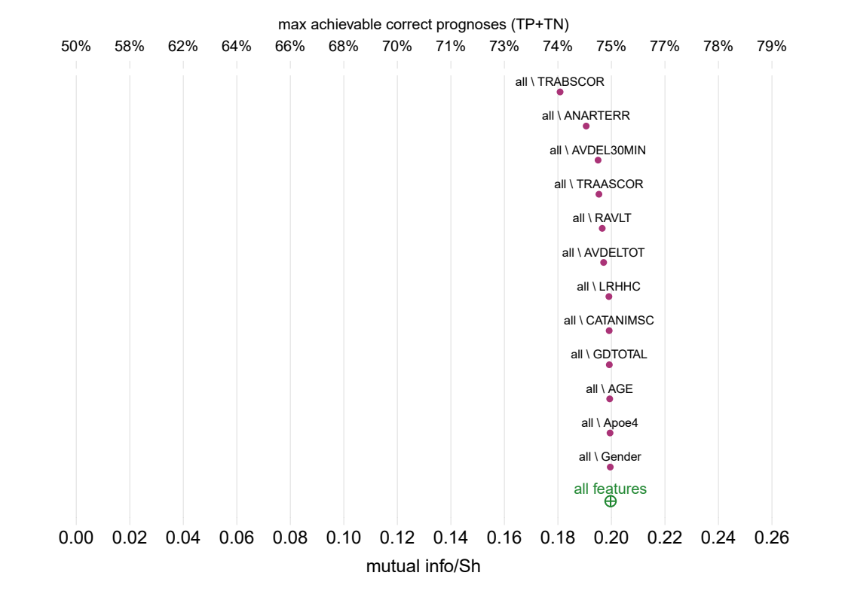
🧠
🧬

Slide 56
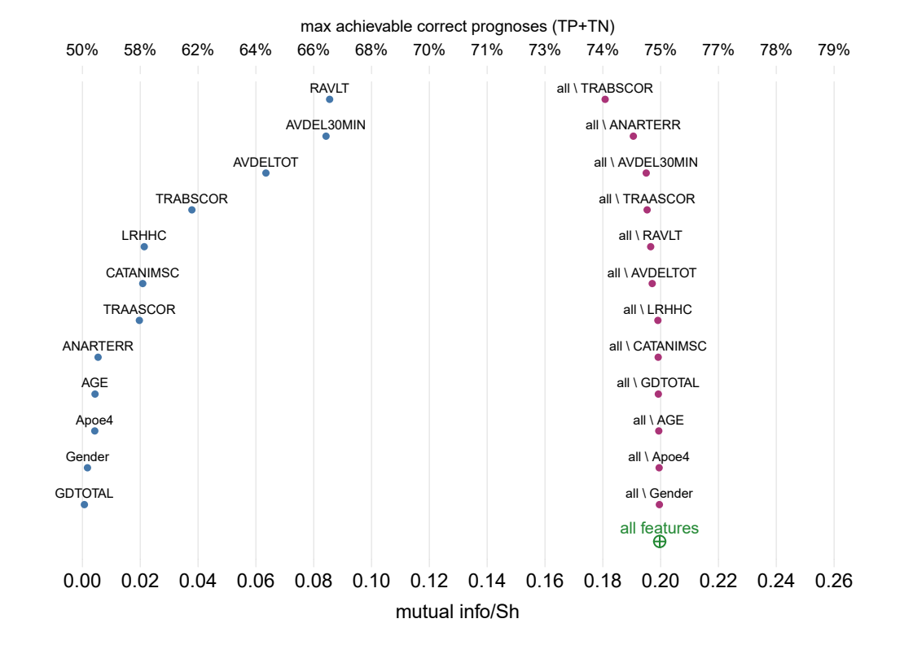
🧠
🧠
🧬
🧬

Slide 57
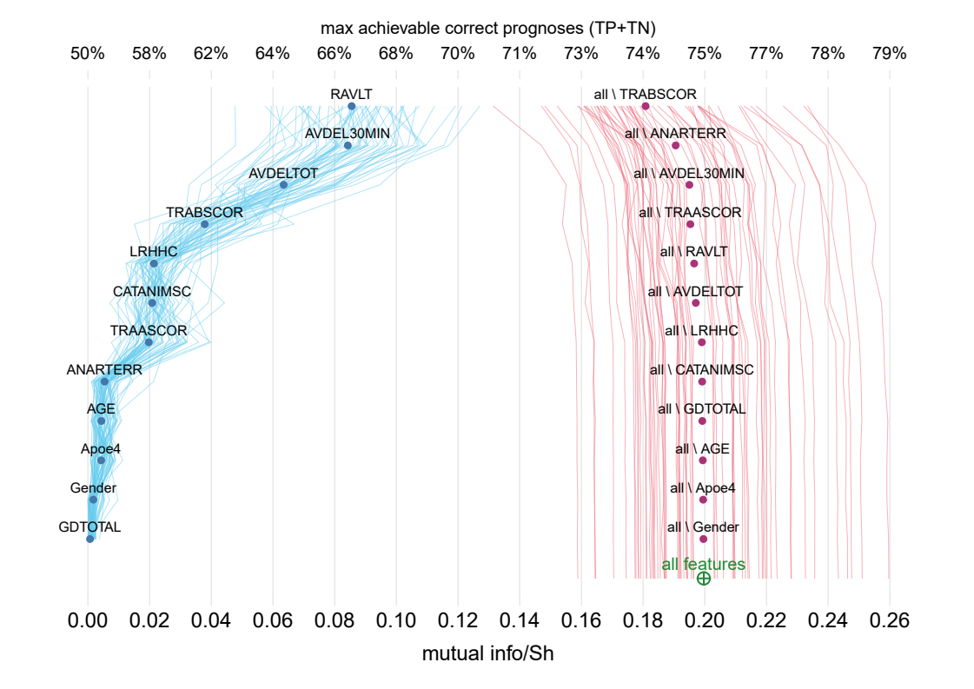
🧠
🧠
🧬
🧬

Slide 58
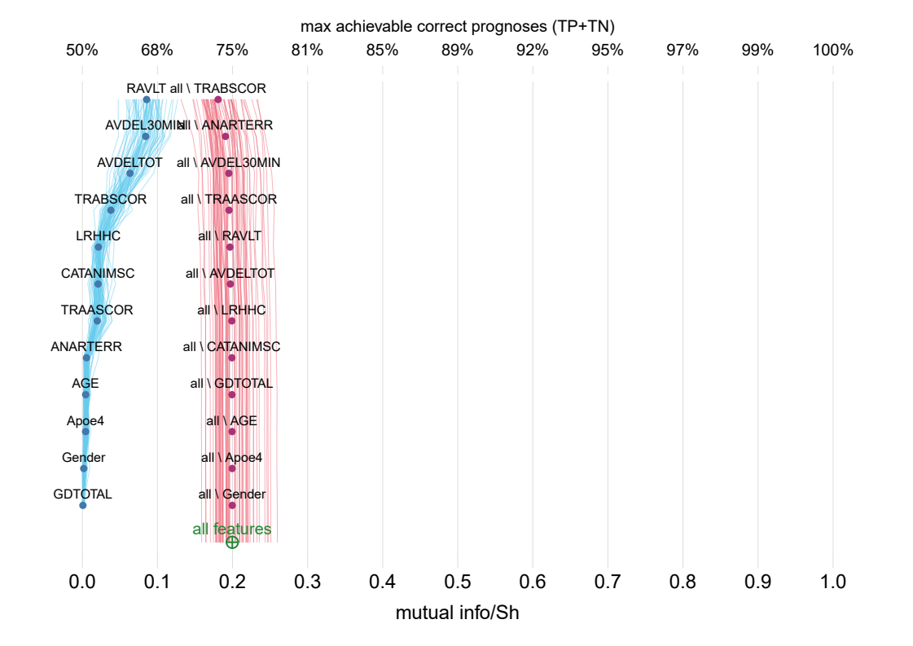
To reach these prognostic levels
we need additional or different features
just changing algorithm won’t work

Slide 59
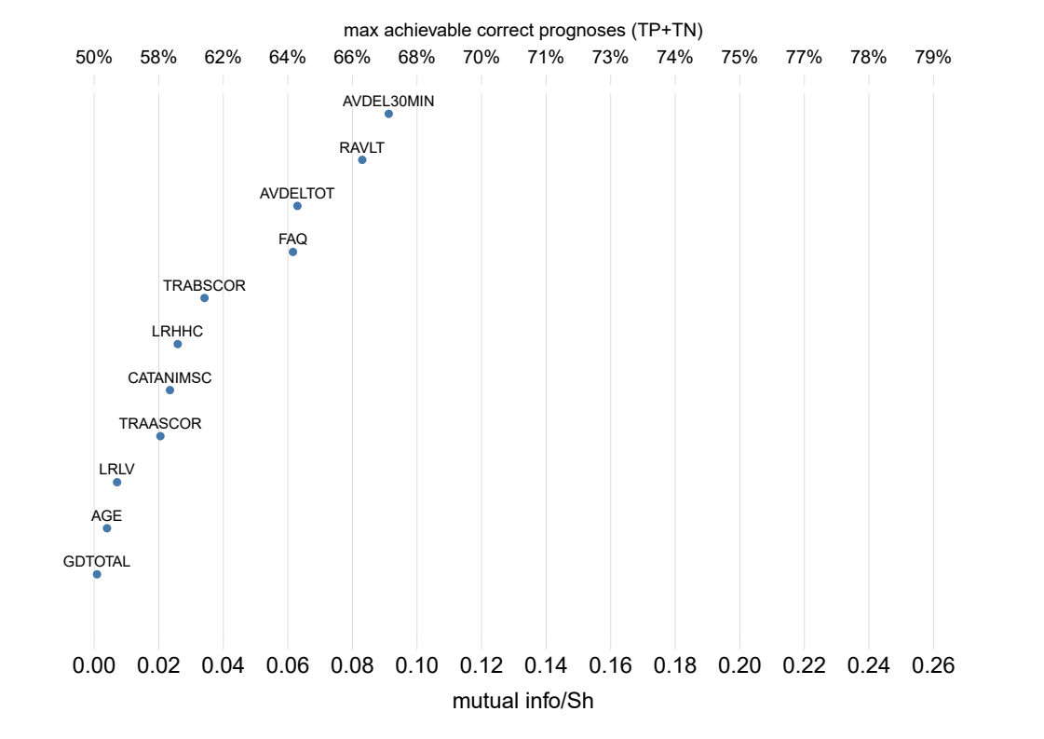
👪
🧠
🧠

Slide 60
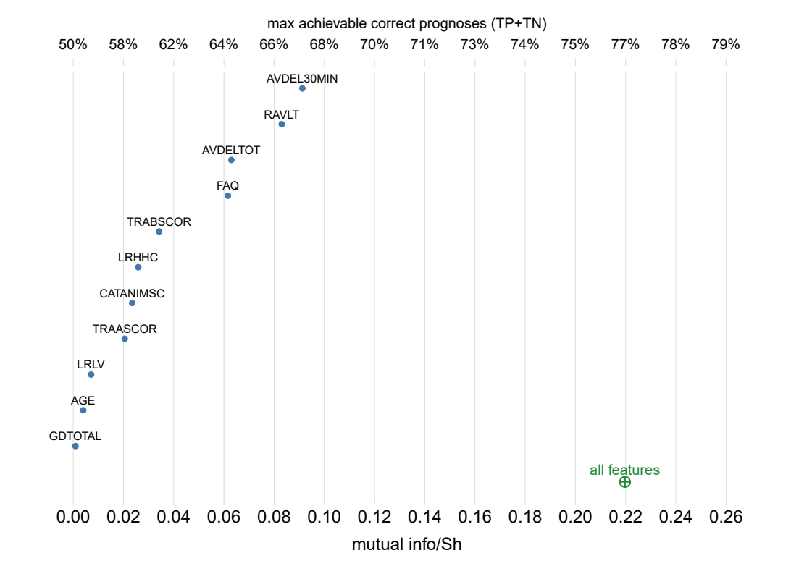
👪
🧠
🧠

Slide 61
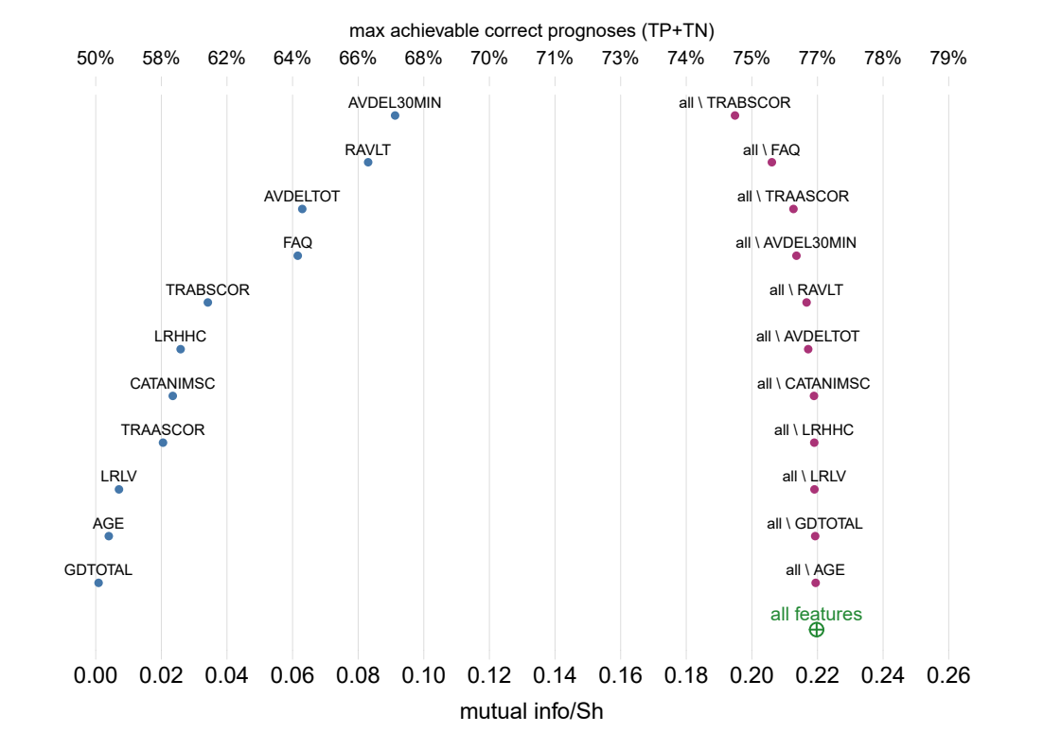
👪
👪
🧠
🧠
🧠
🧠

Slide 62
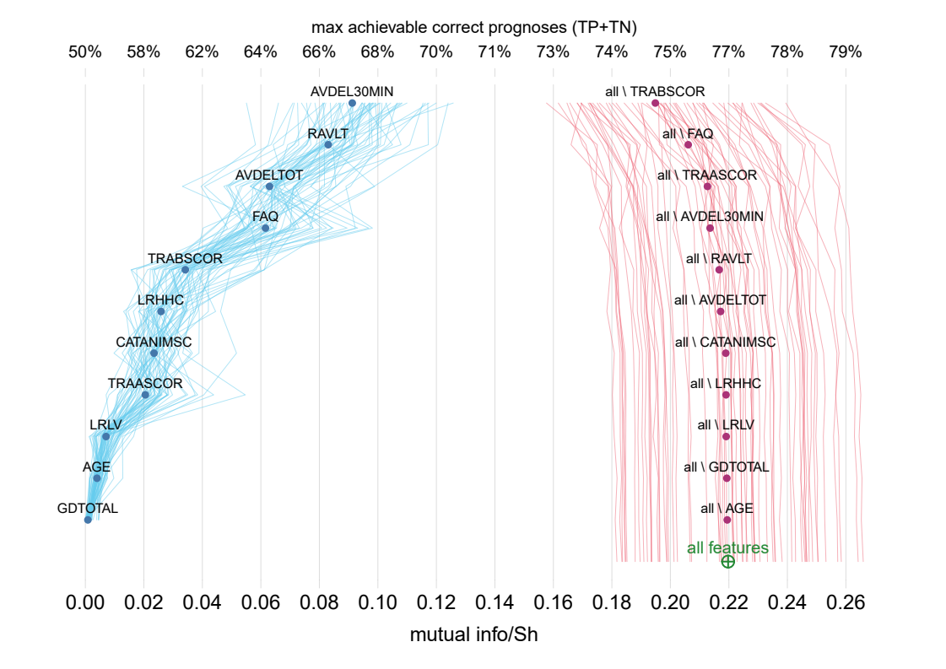
👪
👪
🧠
🧠
🧠
🧠

Slide 64
P(Y|X) P(X) ≡ P(X|Y) P(Y)

Slide 65
!
P(Y|X) P(X) ≡ P(X|Y) P*(Y)

Slide 66
? ? ?
P*(Y|X) P*(X) ≡ P*(X|Y) P*(Y)

Slide 68
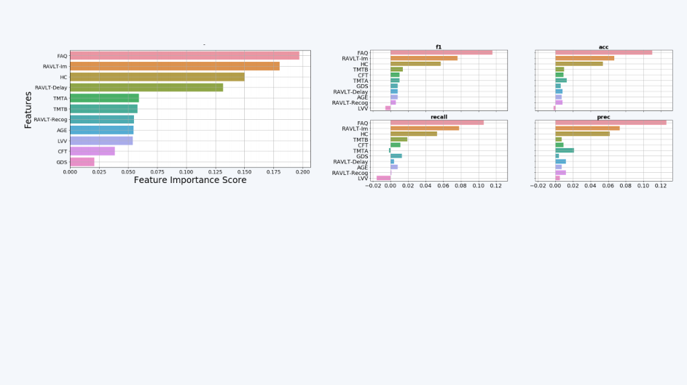
Alexandra’s results

Slide 69
👪
👪
🧠
🧠
🧠
🧠

Slide 70
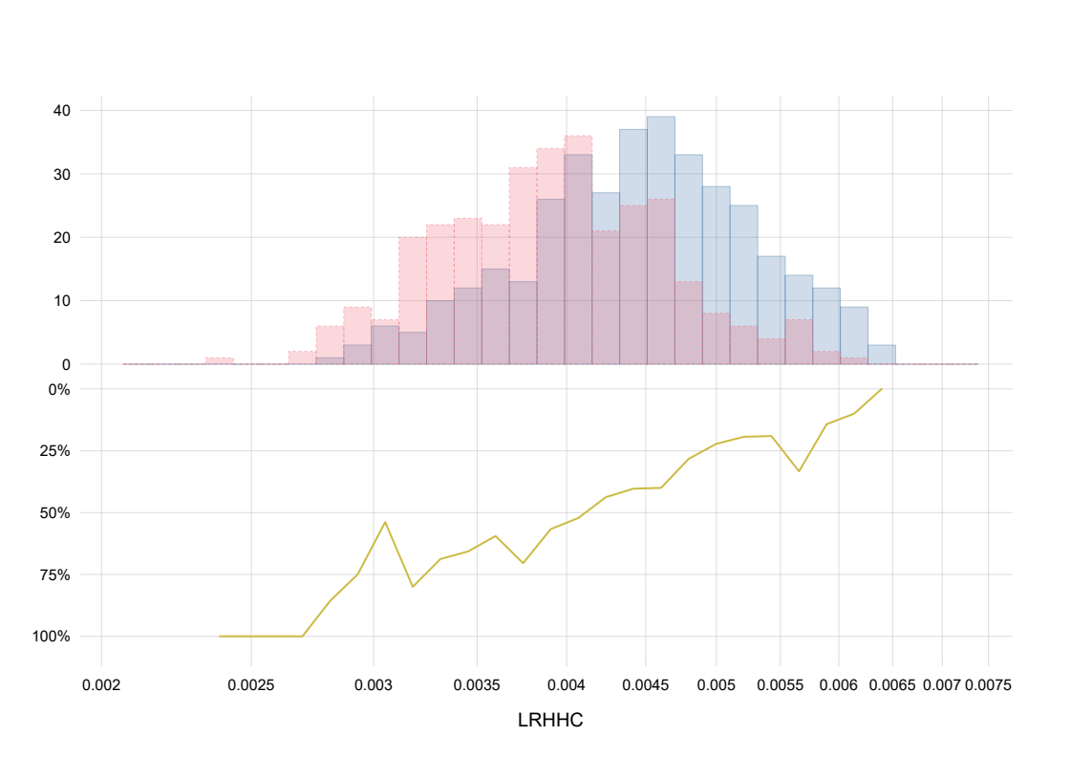
MCI
AD
Prob. of AD onset Sample-data counts

Slide 71
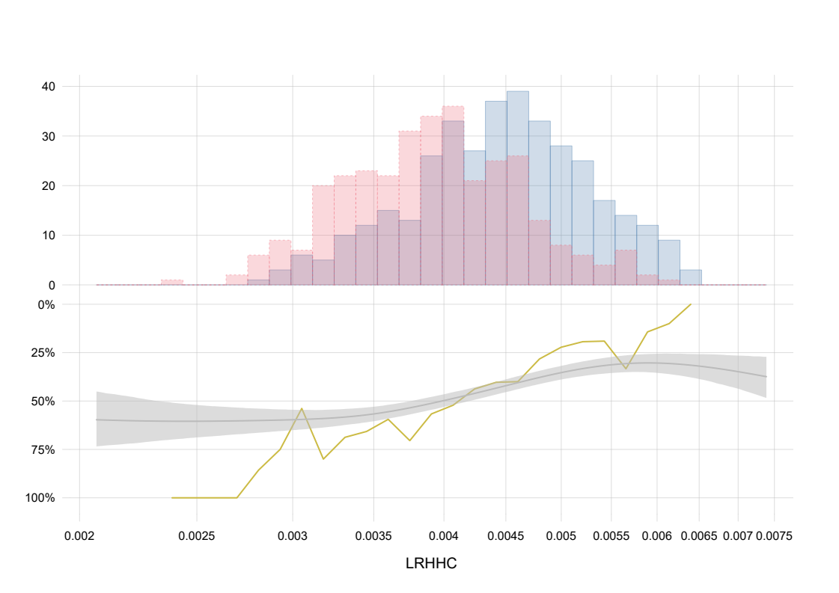
MCI
AD
87.5% credible interval
Prob. of AD onset Sample-data counts

Slide 72
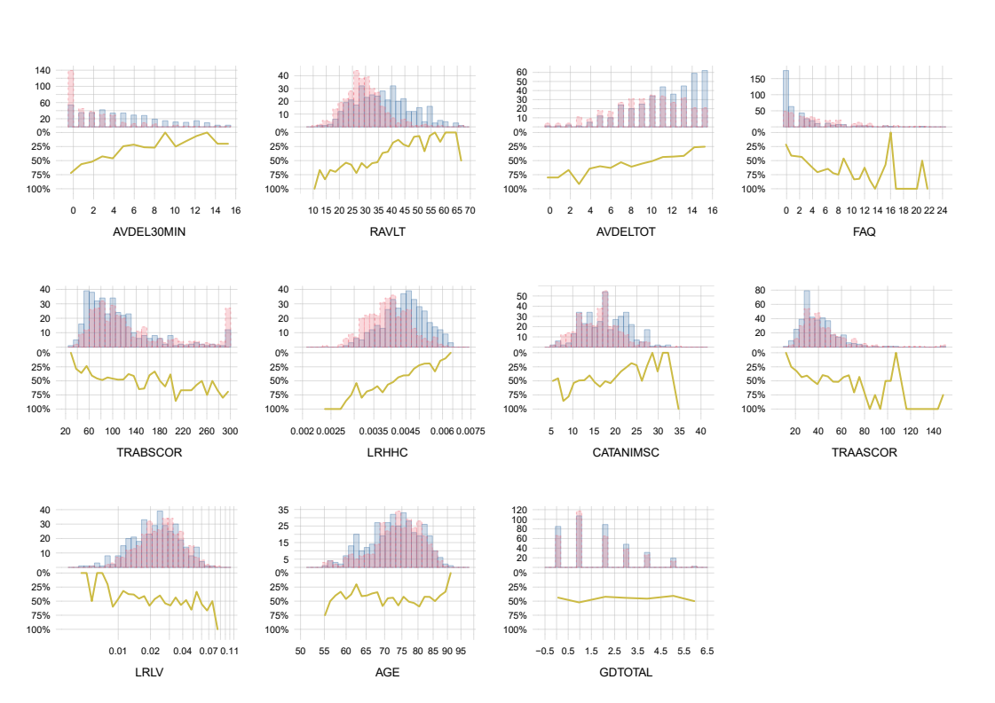
MCI
AD
👪
Prob. AD onset Sample data
🧠
🧠

Slide 73
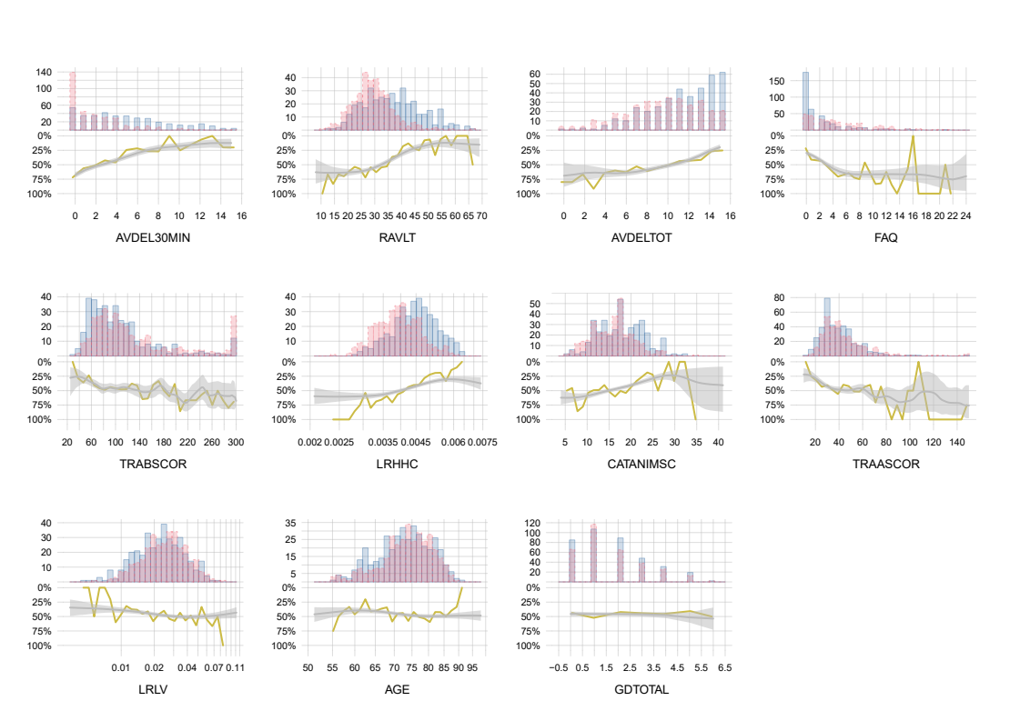
MCI
AD
87.5% credible interval
👪
Prob. AD onset Sample data
🧠
🧠

Slide 74
Thank you!

